Slide 1
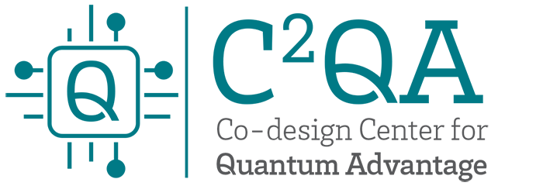





Foundations of
Quantum Information Science (QIS 101)
Dave Biersach
Brookhaven National Laboratory
dbiersach@bnl.gov
Session 07
Information
Theory

Slide 2
Session 07 – Goals
Create and manipulate Python strings
Understand ASCII as an encoding mechanism
Read an ASCII text file stored on disk into a memory buffer
Encrypt and decrypt files using “Caesar Shift”
Generate a histogram of character frequencies within a file
Perform bigram analysis on unreadable ciphertext to determine the author’s native language
Protect digital information using encryption
Advanced Encryption Standard (AES) using a symmetric key
RSA Public Key Encryption using asymmetric keys

Slide 3
Python Strings
Textual data in Python is handled with str objects, commonly known as strings
A Python string is just an array of integers representing Unicode characters – they are not like "C" strings where each character is a byte of fixed size (8 bits)
Python does not have a character type – in Python an individual character is simply another string with len() = 1
Because a Python string is a Sequence type, individual elements can be directly accessed using the [] operator
String literals in your Python source codes must be surrounded by either single or double quotation marks

Slide 4
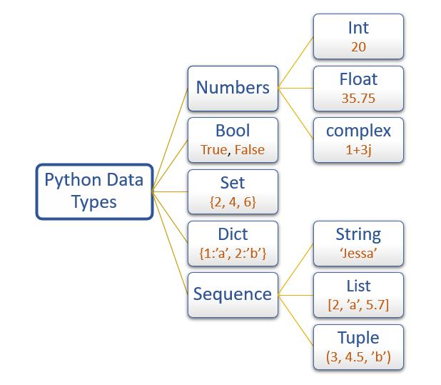
Python Built-In Data Types
https://docs.python.org/3/library/stdtypes.html

Slide 5
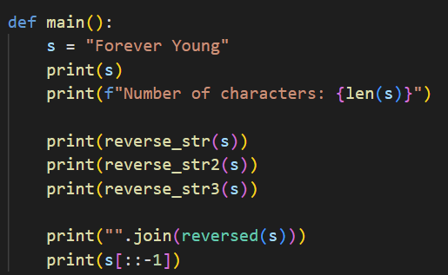
Open reverse_string.py
We could try to swap each letter around the middle element, but that would require complicated code

Slide 6
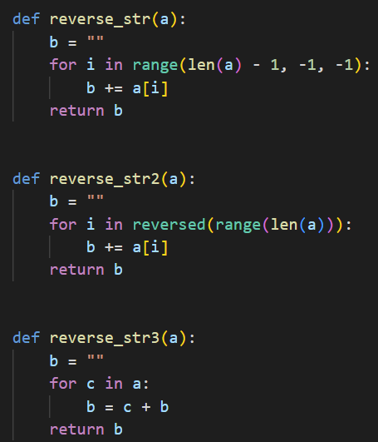
Open reverse_string.py
①
②
③
④
⑤
⑥
⑦
⑧
⑨

Slide 7
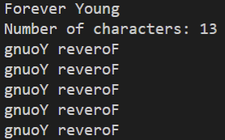
Run reverse_string.py
①
②
Adopt a functional programming mindset
①
②
https://problemsolvingwithpython.com/05-NumPy-and-Arrays/05.06-Array-Slicing
https://www.w3schools.com/python/numpy/numpy_array_slicing.asp

Slide 8
ASCII (“as-key”)
American Standard Code for Information Interchange
ASCII was the most common legacy International standard used across the Internet until 2007
Since 2008 ASCII has been surpassed by UTF-8 (Universal Transformation Format), which includes ASCII as a subset
ASCII is an 8-bit (one byte) character encoding scheme
ASCII maps most of the characters in the (Western) languages descending from Latin to a specific integer value
In ASCII there is a 1:1 correspondence between a letter and a number and every character is always one byte long
Inside a computer, all letters, punctuation marks, even numbers (when treated as strings) are encoded as either ASCII or UTF

Slide 9
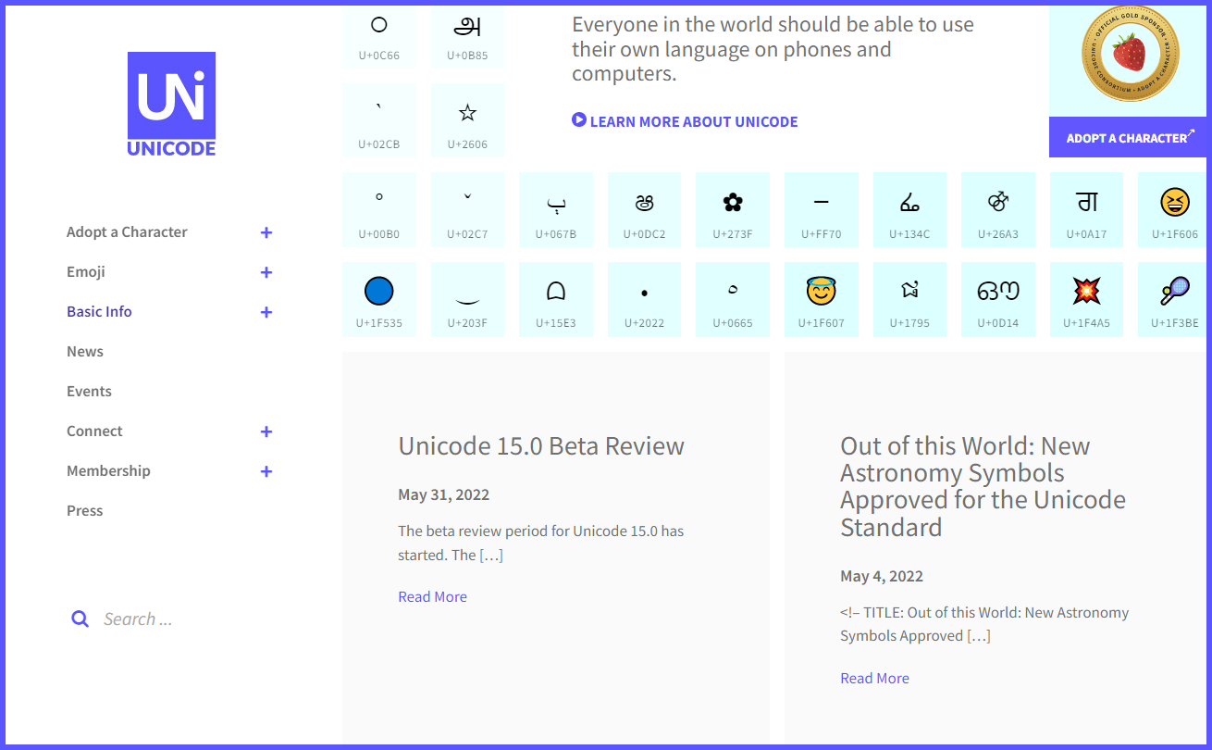
Unicode
https://home.unicode.org

Slide 10
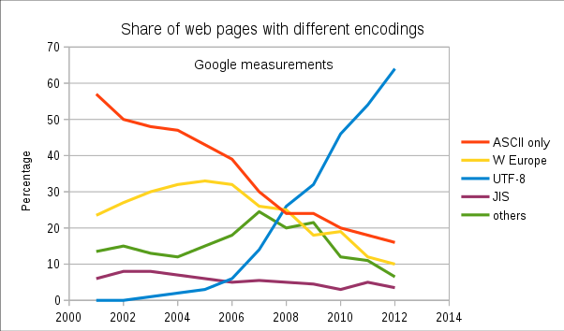
Learn about UTF-8
https://en.wikipedia.org/wiki/UTF-8

Slide 11
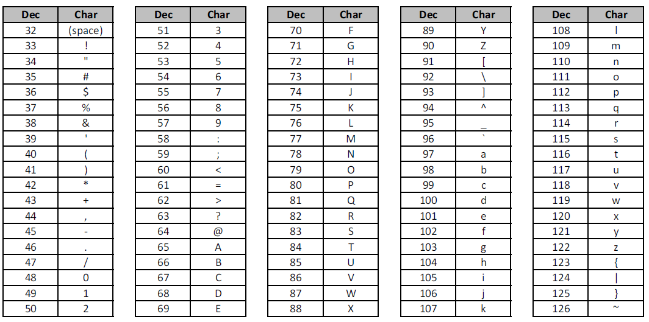
ASCII range for common English characters

Slide 12
Creating a Frequency Histogram
Consider Lincoln’s Gettysburg Address:
Four score and seven years ago our fathers brought forth on this continent a new nation, conceived in liberty, and dedicated to the proposition that all men are created equal.
Now we are engaged in a great civil war, testing whether that nation, or any nation so conceived and so dedicated, can long endure…
We want to perform a histogram analysis of Lincoln’s speech that has been saved as an ASCII text file
What letter do you think occurs most frequently in English?
Spaces (ASCII value 32) usually occur most often because we use spaces as a word breaker

Slide 13
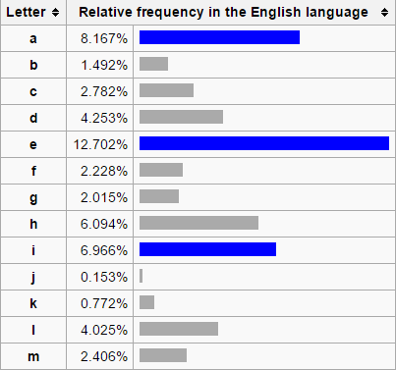
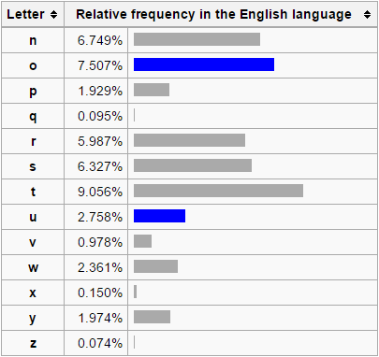
Letter Frequencies in the English Language
ETAOIN SHRDLU

Slide 14
ASCII Text Files – A “stream”
A file on disk is essentially just a byte array
A byte is an 8-bit unsigned integer between 0 and 255
We can declare a byte array and load it with the contents of a file
A stream of file bytes in memory is called a buffer
We can then access any individual character within the file
Use the normal [] operator on this vector of "fileBytes"
We only need to specify an index value to get a specific byte

Slide 15
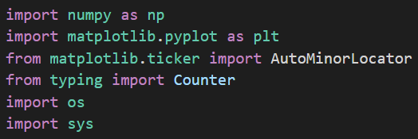
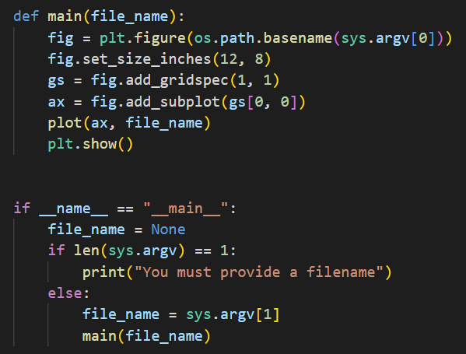
Open freq_histogram.py
①
⑧
⑨
⑩
②
③
④
⑤
⑥
⑦

Slide 16
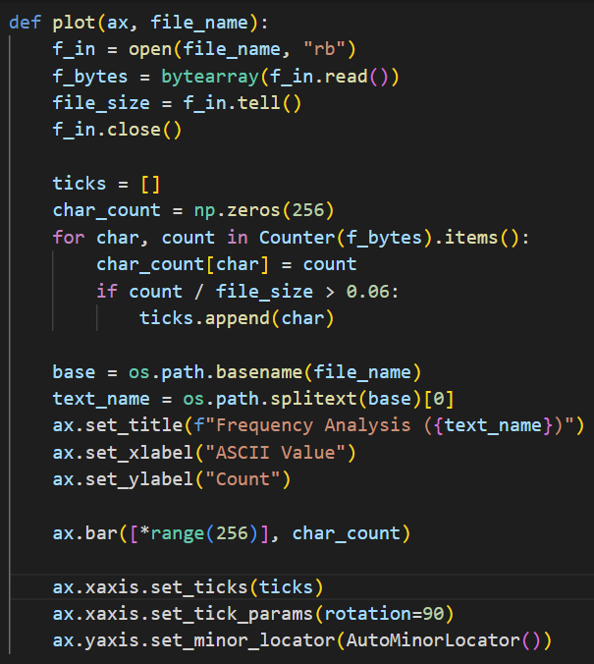
View freq_histogram.py
①
②
③
④
⑤
⑥
⑦
⑧
⑨
⑩

Slide 17
View freq_histogram.py
①
②
③
Lazy Evaluation in Python
④
⑤
⑥

Slide 18
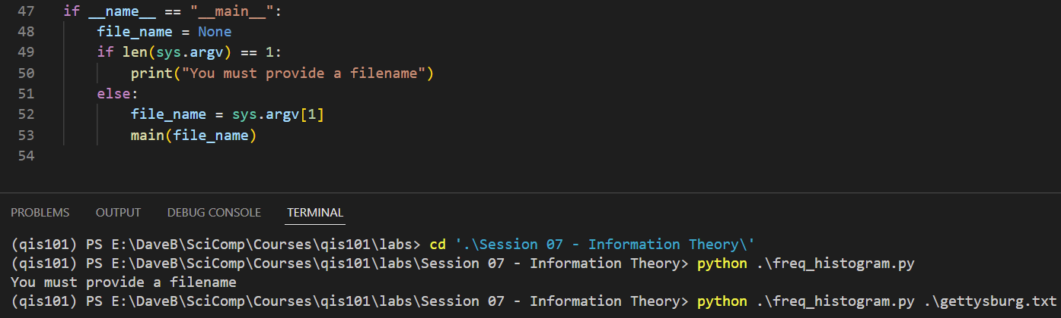
Run freq_histogram.py
You must enter these two commands in the TERMINAL window in
VS Code
cd ".\Session 07 - Information Theory\"
python .\freq_histogram.py .\gettysburg.txt

Slide 19
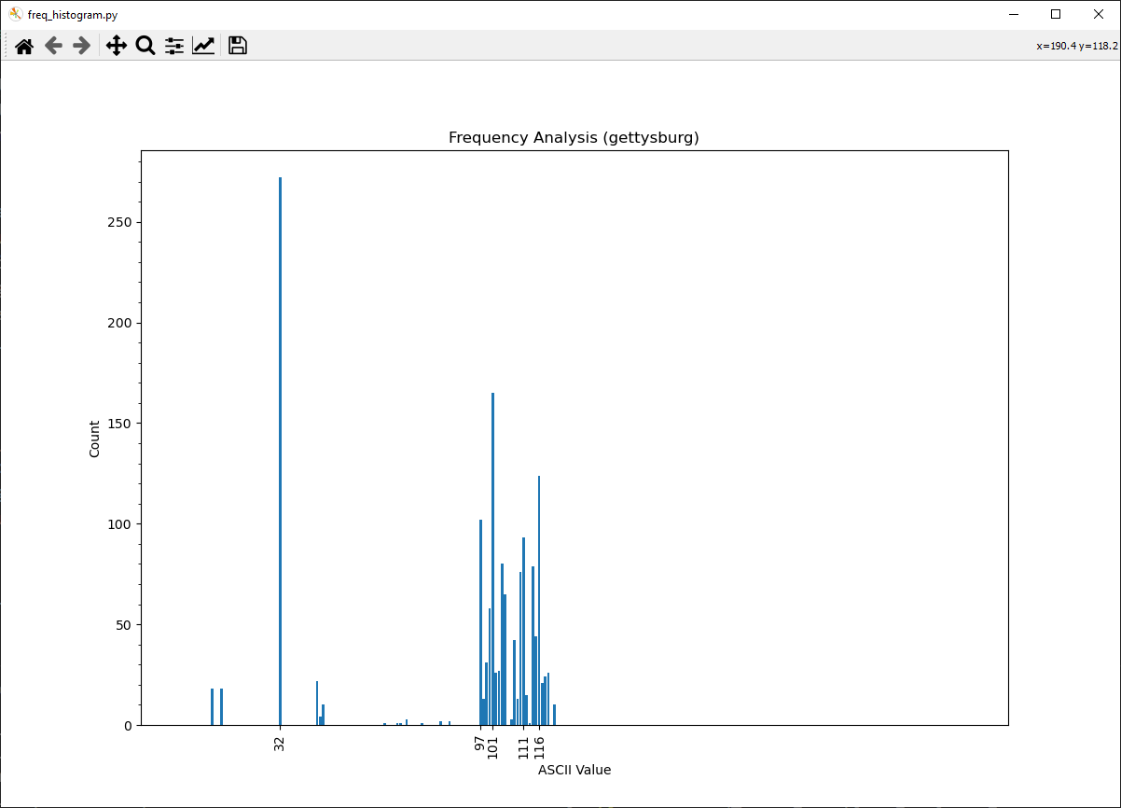
Run freq_histogram.py
You must close the plot window to return to
VS Code
ASCII value 32 (space) appears most often
ASCII value 101 (e) is most frequent letter

Slide 20
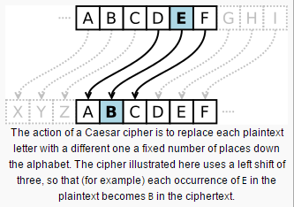
The Caesar Shift Cipher
Roman Emperor Julius Caesar used a simple (but effective for its time) encryption scheme for his private correspondence
To create “cipher text” from “plain text” simply shift the original letters forward (or backward) a given number of letters in the alphabet
To decrypt the message, simply reverse the sign of the shift

Slide 21
The Caesar Shift Cipher
Consider Lincoln’s Gettysburg Address:
Four score and seven years ago our fathers brought forth on this continent a new nation, conceived in liberty, and dedicated to the proposition that all men are created equal.
Now we are engaged in a great civil war, testing whether that nation, or any nation so conceived and so dedicated, can long endure…
How effective is the Caesar Shift at encrypting plaintext?
What if we shifted each letter by just one position?
Simply add +1 to the ASCII value of each plaintext character
Save the shifted values to a new ciphertext file

Slide 22
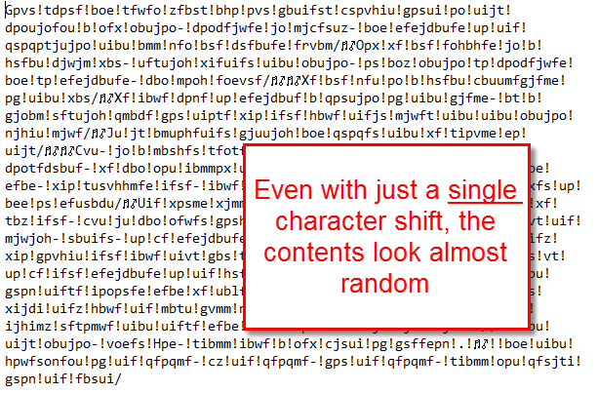
The Caesar Shift Cipher

Slide 23
The Caesar Shift Cipher
If we are given a text file written in English and encrypted by a Caesar Shift, can we figure out what shift value was used?
We could use “brute force” and try every possible value to see what shift produces legible prose…
But we'd need to possibly try every shift value from +1 to +255
It would take a long time to sift through all the decrypted files because all incorrect shift values generate more gibberish
Can we gleam any insight from analyzing the character histogram of the encrypted file?

Slide 24
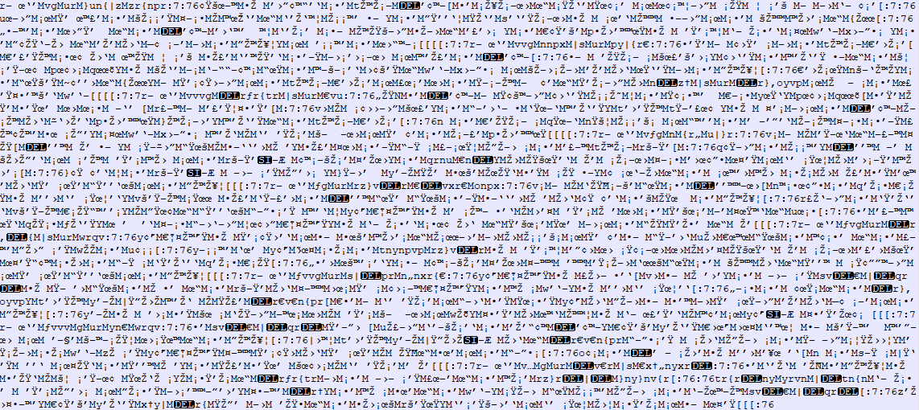
ciphertext1.txt
What shift made this?

Slide 25
Run freq_histogram.py
You must enter this command in the TERMINAL window in
VS Code
python .\freq_histogram.py .\ciphertext1.txt

Slide 26
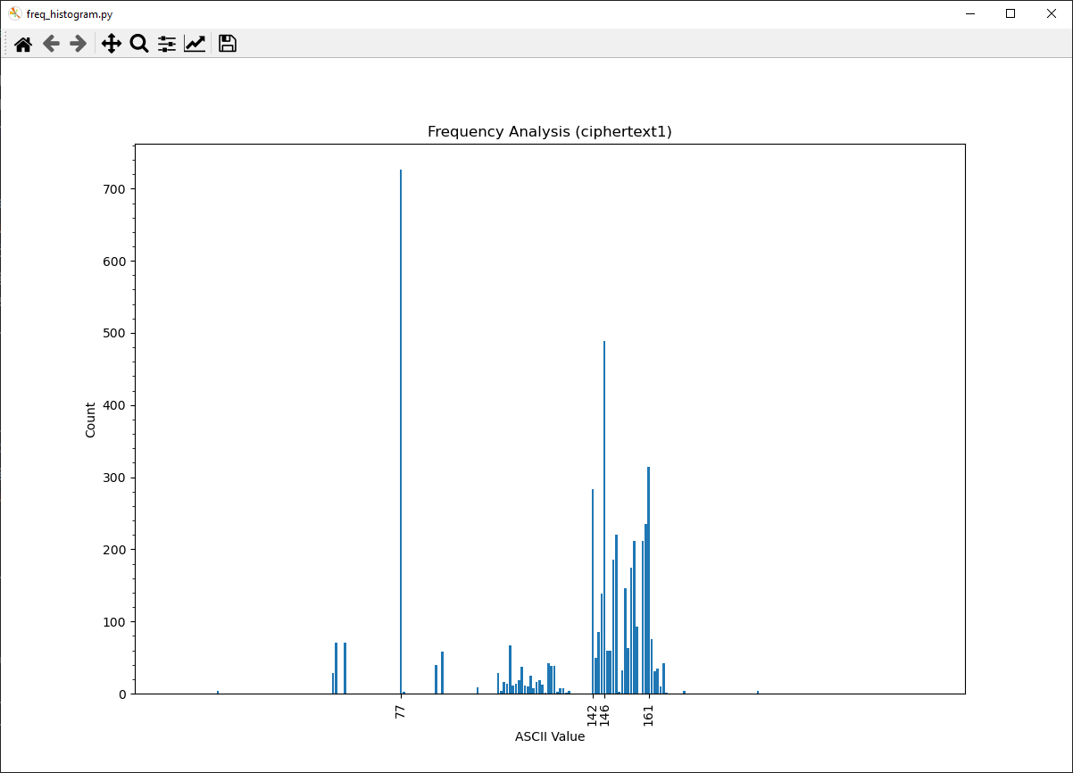
Run freq_histogram.py
What shift value was used for this Caesar encryption?

Slide 27
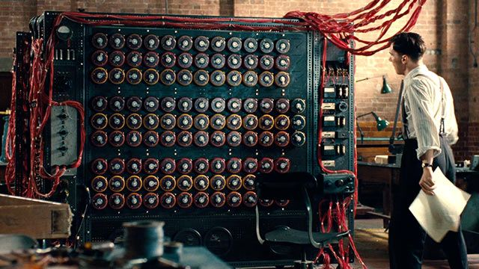
Caesar Decrypt
Your mission is to decrypt the ciphertext1.txt file
What if the survival of your country depended upon your ability to crack the encryption?

Slide 28
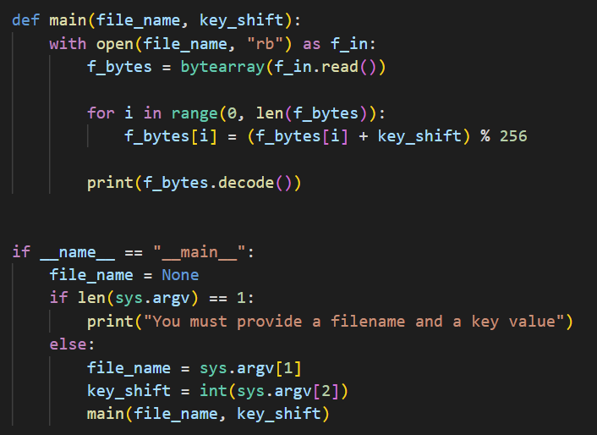
Open caesar_decrypt.py
⑥
⑦
Python Context Managers
⑧
⑨
⑩
①
②
③
④
⑤

Slide 29
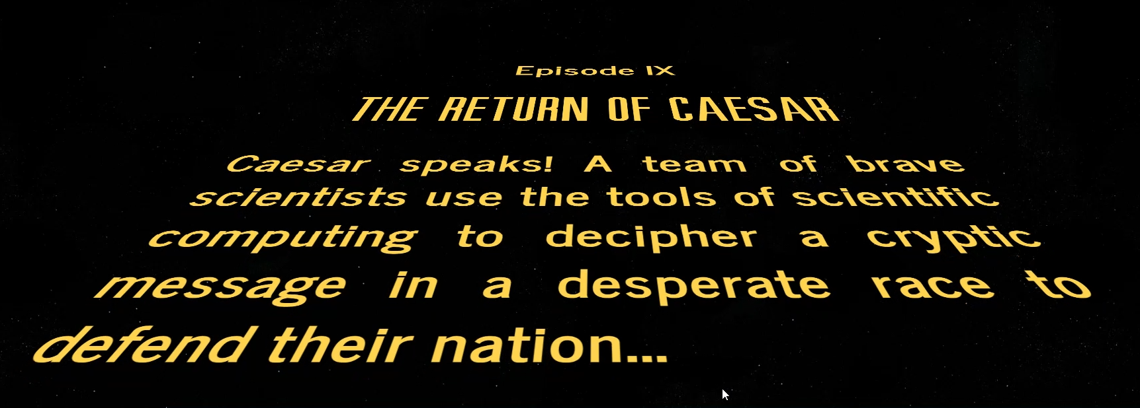

Slide 30
Run caesar_decrypt.py
python .\caesar_decrypt.py .\ciphertext1.txt -45
The decryption key is the inverse (negative) shift value

Slide 31
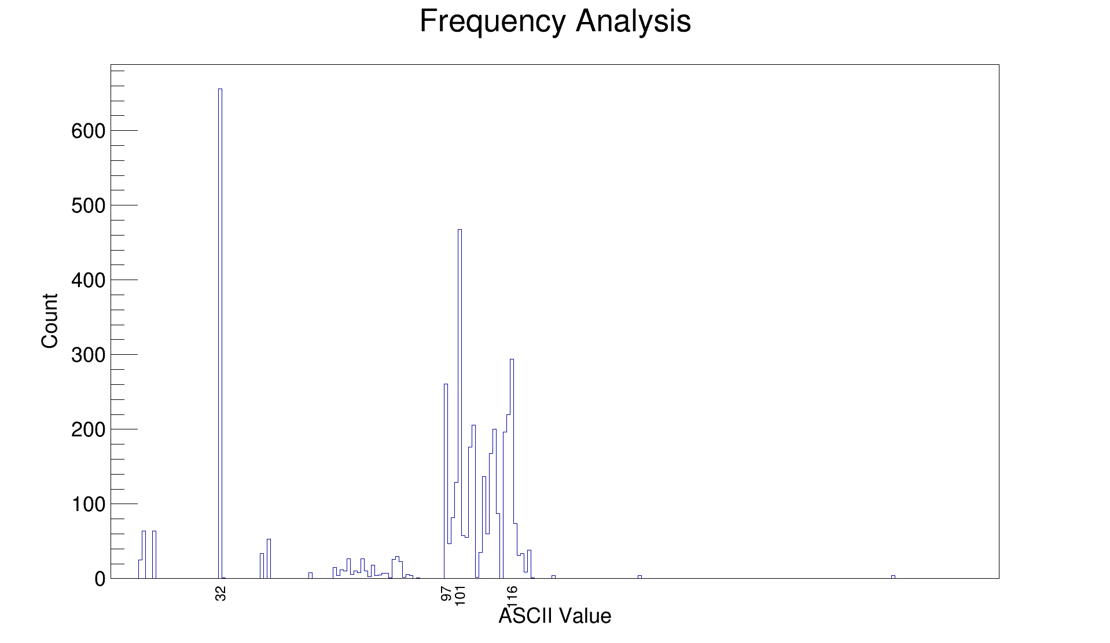
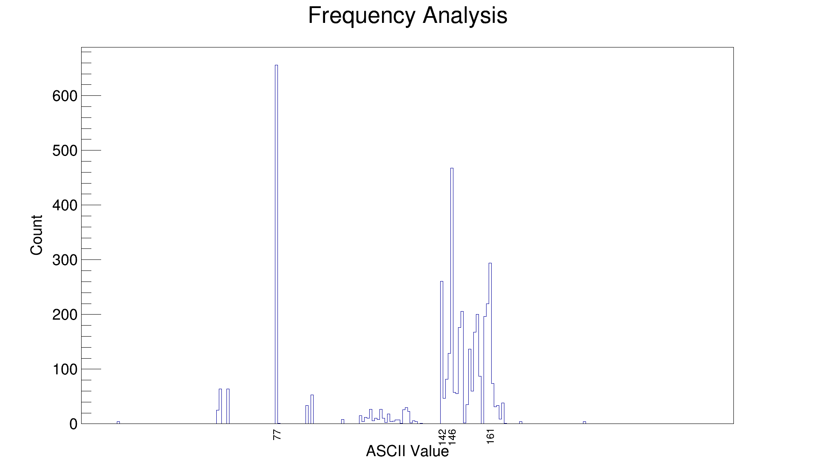
plaintext
Notice the relative letter frequencies (individual bar heights) are the same before and after encryption
ciphertext

Slide 32
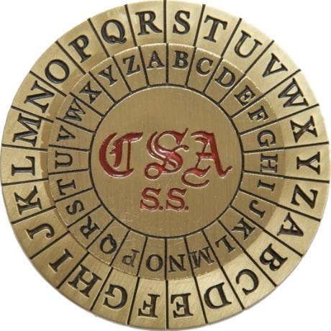
The Caesar Shift Cipher
Because the Caesar Shift is a monoalphabetic substitution cipher, it is susceptible to cryptanalysis (breaking) by frequency analysis

Slide 33
Bigram Analysis
Most Western (Latin influenced) languages have a unique fingerprint from their most frequent bigrams (two-letter pair)
In English the bigrams TH and HE occur most often, since “the” is the most frequent word in English
All languages have definite articles like “the” but each language spells theirs differently, and this helps establish a distinct statistical profile for each language
Linguists and statisticians have compiled lists of the most frequent bigrams per language
We can analyze the bigrams in President Kennedy’s Rice University Speech - where he set the goal in 1962 for the USA to reach the moon before 1970!

Slide 34
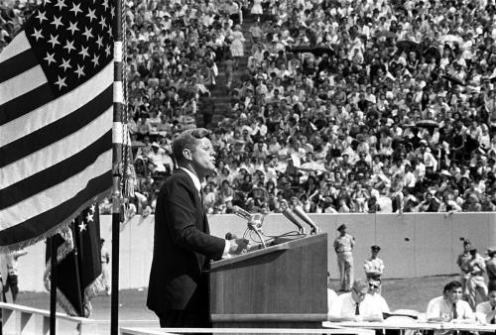
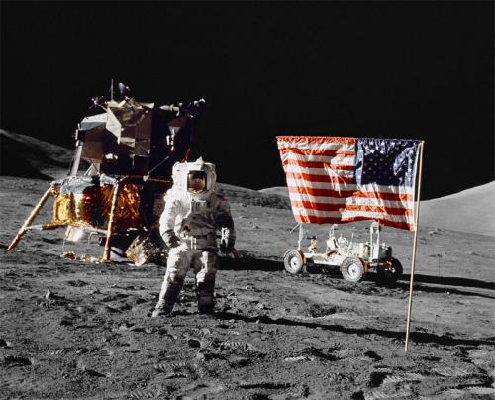
Kennedy’s Moon Speech in 1962
“We choose to go to the moon in this decade and do the other things, not because they are easy, but because they are hard, because that goal will serve to organize and measure the best of our energies and skills, because that challenge is one that we are willing to accept, one we are unwilling to postpone, and one which we intend to win.”

Slide 35
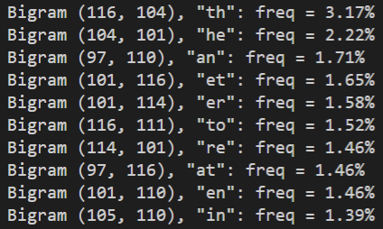
Bigram Analysis of Kennedy’s Moon Speech in 1962

Slide 36
Kennedy’s Moon Speech Translated
Nous choisissons d'aller sur la lune. Nous choisissons d'aller sur la lune dans cette décennie et de faire d'autres choses, non pas parce qu'ils sont faciles, mais parce qu'ils sont difficiles, parce que ce but servira à organiser et mesurer le meilleur de nos énergies et de compétences, parce que ce défi est l'un que nous sommes prêts à accepter, que nous ne sommes pas disposés à reporter, et celui qui nous avons l'intention de gagner.
Elegimos ir a la Luna. Elegimos ir a la Luna en esta década y hacer las otras cosas, no porque sean fáciles, sino porque son difíciles, porque esa meta servirá para organizar y medir lo mejor de nuestras energías y habilidades, porque ese desafío es uno que estamos dispuestos a aceptar, uno no estamos dispuestos a posponer, y uno que tenemos la intención de ganar.
Wir wählen, um zum Mond zu fliegen. Wir wählen, um zum Mond in diesem Jahrzehnt zu gehen und die anderen Dinge, nicht weil sie leicht sind, sondern weil sie hart sind, denn das Ziel wird dazu dienen, zu organisieren und zu messen, das Beste aus unserer Energien und Fähigkeiten, denn das ist eine Herausforderung dass wir bereit sind zu akzeptieren, das wir nicht bereit sind, zu verschieben, und eine, die wir beabsichtigen, zu gewinnen.

Slide 37
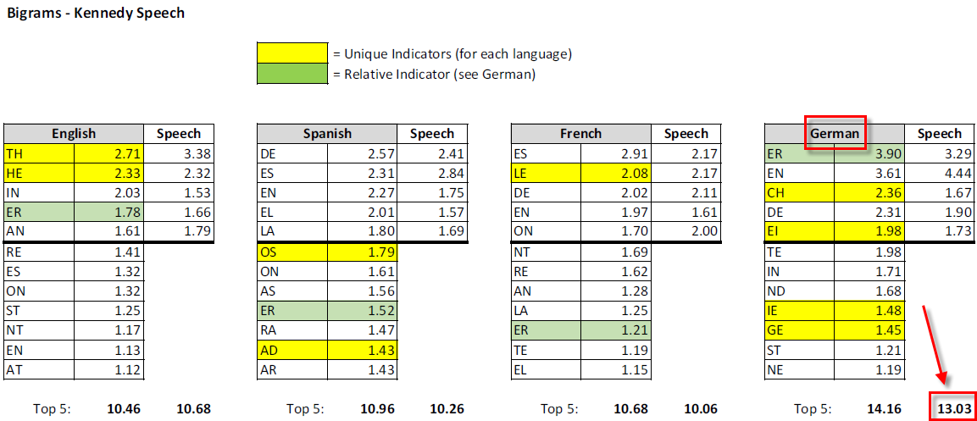
Bigram Statistics by Language
German is the most consistent language for bigrams

Slide 38
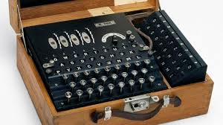
Frequency of Bigrams
I found an encrypted text file on the dark web
It was encrypted with a monoalphabetic substitution cipher
Frequency analysis does not suggest a simple Caesar shift was used
Rather, a different shift value was used for each plaintext letter!
Even if we are unable to break the encryption, can we tell what language was used when writing the plaintext?
Q: Are you serious? How can you possibly discern the author's language if you cannot even read the contents in the first place?
A: Enigma was also unbreakable

Slide 39
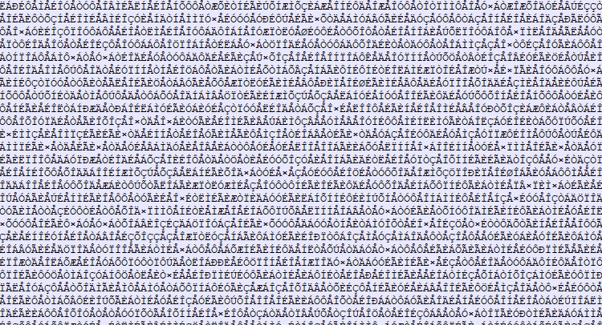
bigram_ciphertext.txt
What was the source language?

Slide 40
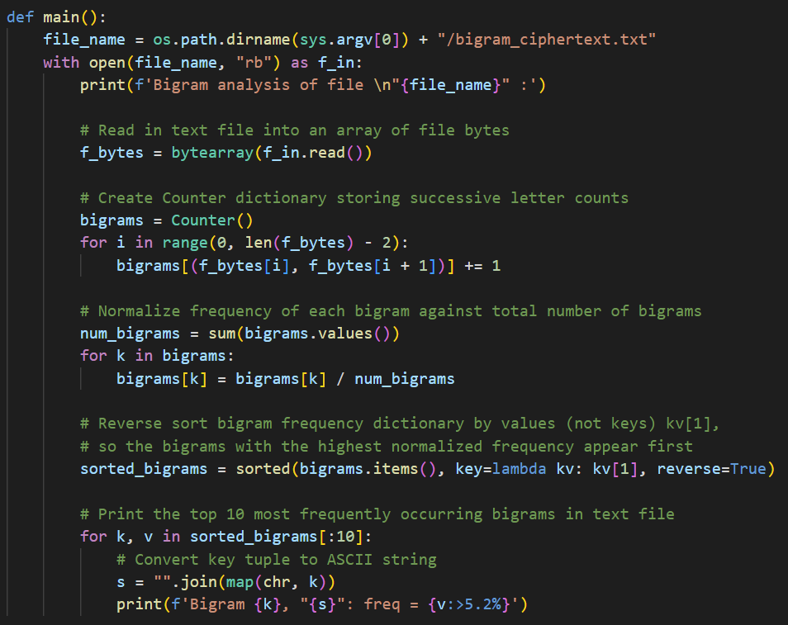
Open bigram_frequency.py
①
②
③
④
⑤
⑥
⑦
⑧
⑨
⑩

Slide 41
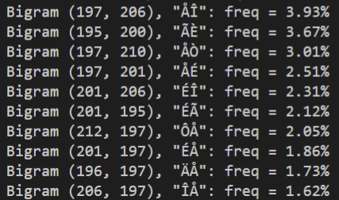
Run bigram_frequency.py
Consider the frequencies of the most recurring bigrams in the cipher text.
What language has this level of bigram consistency?

Slide 42
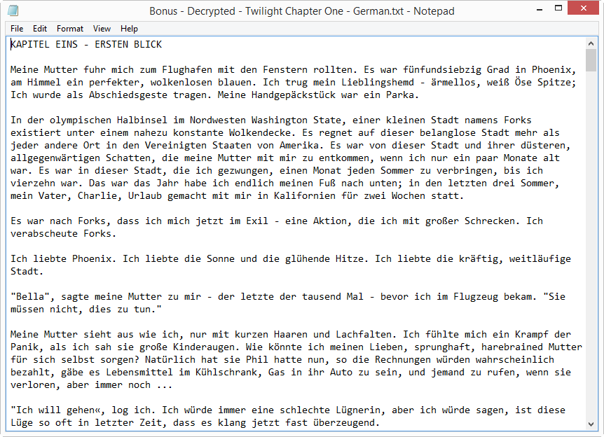
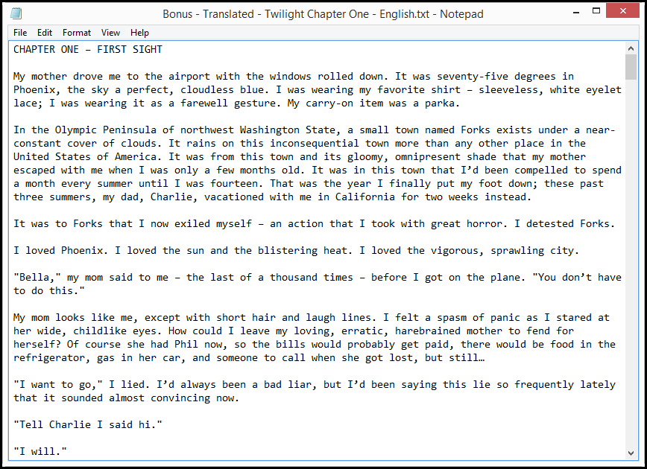

The Original Plaintext

Slide 43
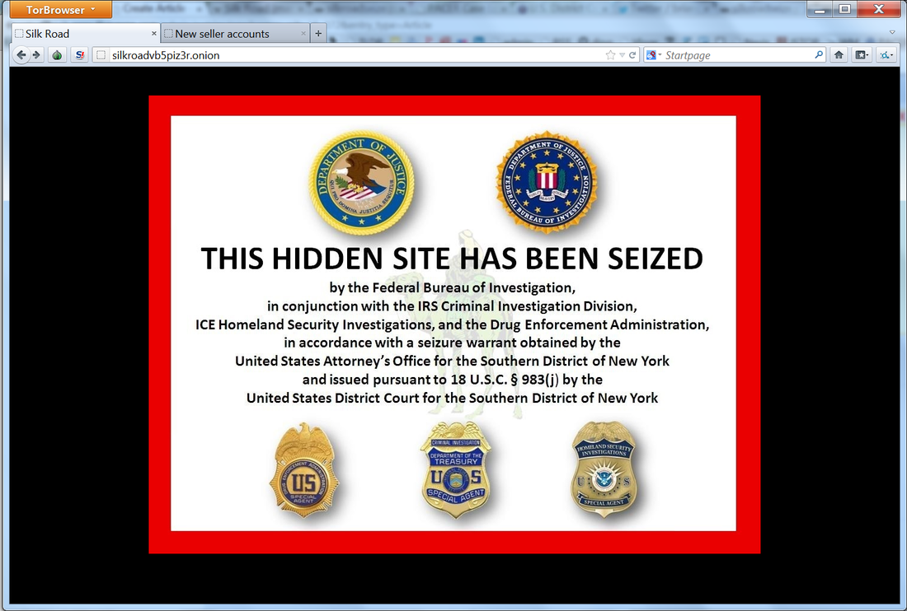
The Fallacy of the Smarter Criminal

Slide 44
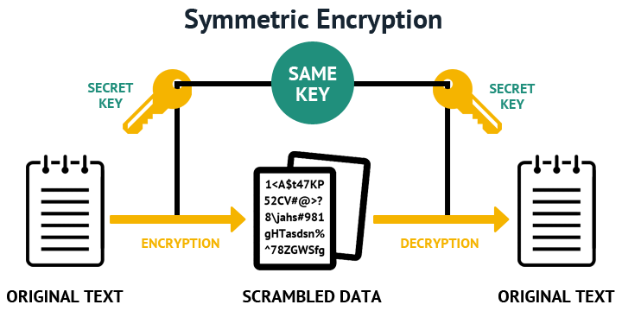

Modern Encryption
How does AES encryption work? (13 mins)

Slide 45
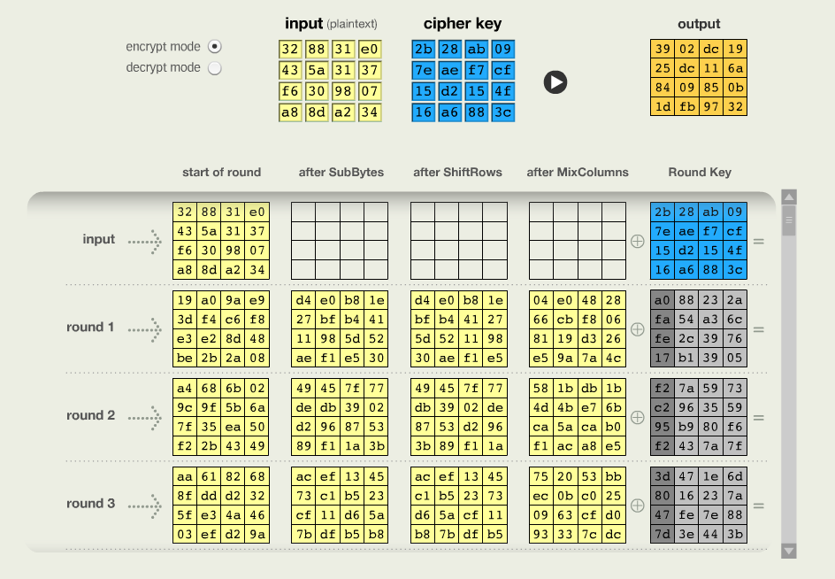
The Advanced Encryption Standard

Slide 46
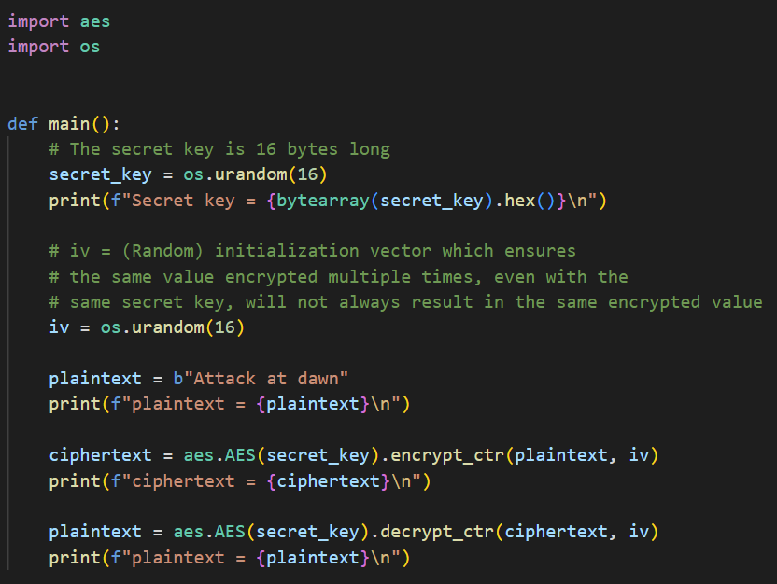
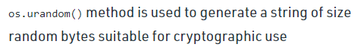
Open aes_demo.py
①
②
③
④
⑤
⑥
⑦

Slide 47
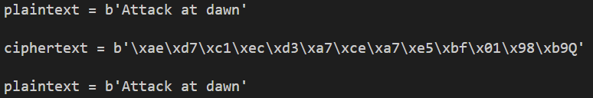
Run aes_demo.py
①
②
③

Slide 48
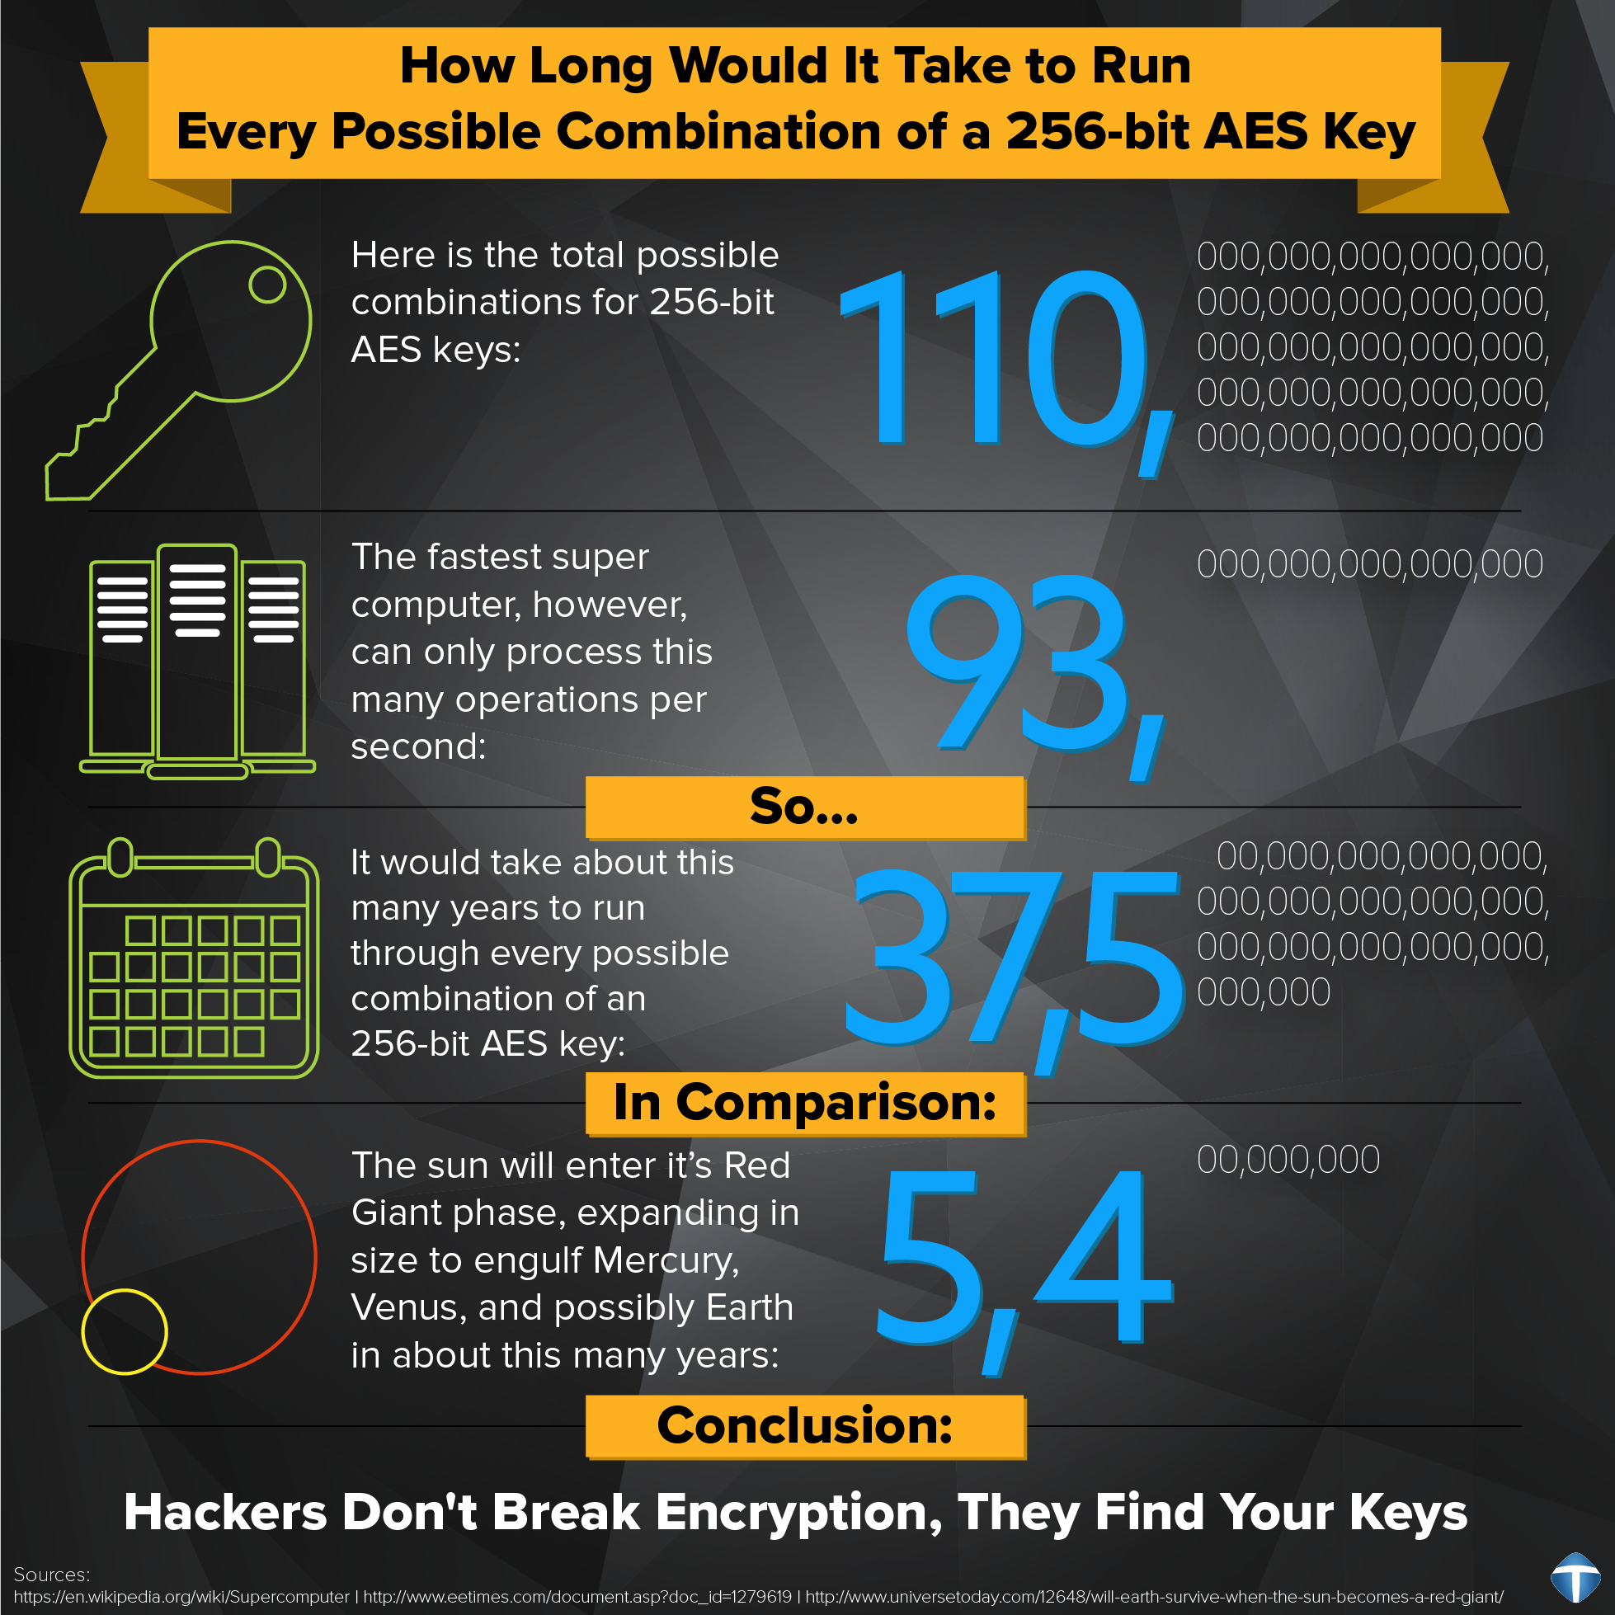
The Advanced Encryption Standard

Slide 49
The Key Distribution Problem
Symmetric schemes require both parties to share a common key before they can communicate securely
The issue is how to quickly & securely distribute this key between two parties who don't know each other, are separated by distance, and have no private communication channel between them
Some mechanism is required for secure transmission of the key – this is called key distribution
Secure systems fail most often when there was a break in the key distribution scheme – the actual encryption algorithm (underlying mathematics) is rarely broken

Slide 50
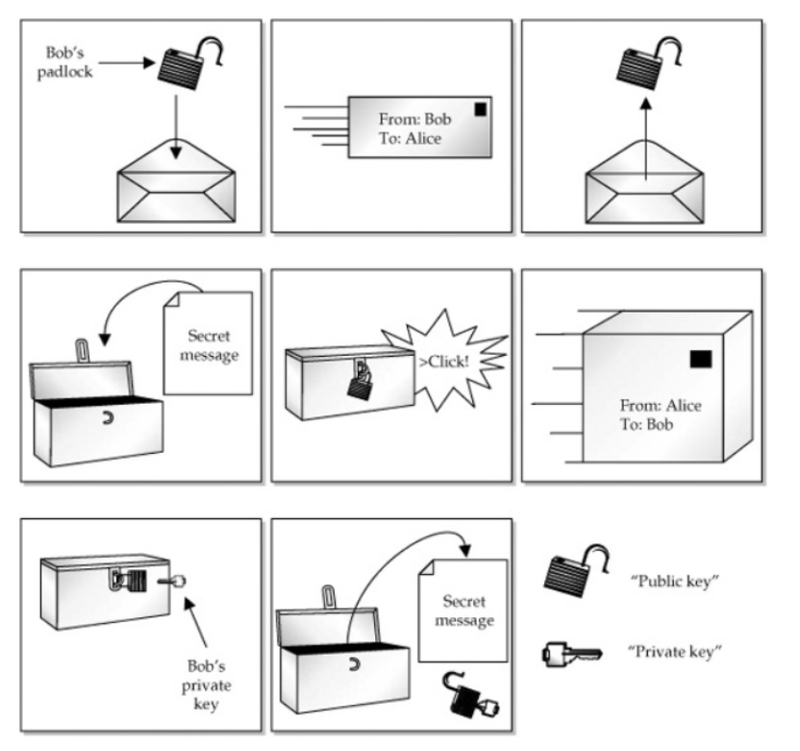
A Physical Solution

Slide 51
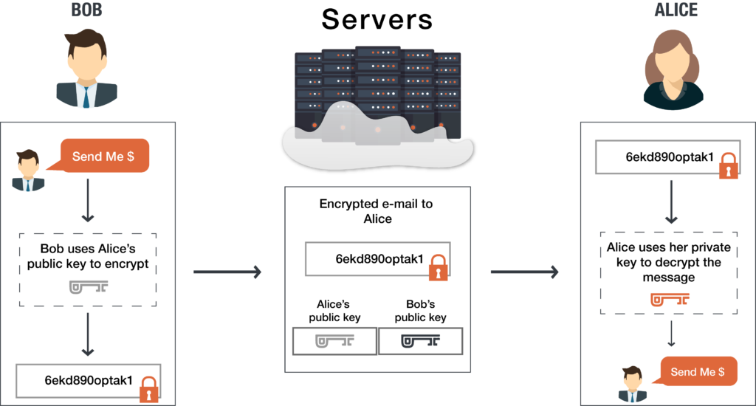
Asymmetric Encryption (Public Key)

Slide 52
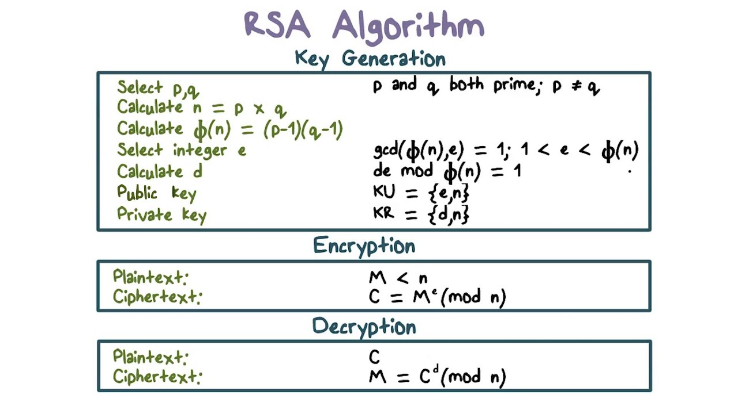
Asymmetric Encryption (Public Key)
"key user"
"key receiver"
Ron Rivest, Adi Shamir, Leonard Adelman (1983)

Slide 53
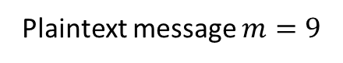
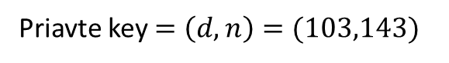
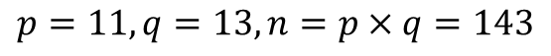
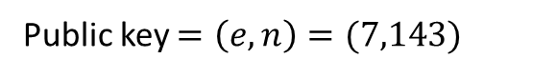
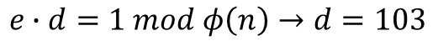


RSA Algorithm (Worked Example)
$$p=11, q=13, n=p×q=143$$
Euler's Totient
$$φ\left(n\right)=\left(p−1\right)\left(q−1\right)=\left(10\right)\left(12\right)=120$$
Extended Euclidean Algorithm
$$e=7,\gcd\left(e,φ\left(n\right)\right)=1$$
$$e∙d=1 mod φ\left(n\right)→d=103$$
Public key $=\left(e,n\right)=(7,143)$
Priavte key $=\left(d,n\right)=(103,143)$
Plaintext message $m=9$
Ciphertext $m^{e} mod n=9^{7} mod 143=48=c$
Plaintext $=c^{d} mod n={48}^{103} mod 143=9=m$

Slide 54







Extended Euclidean Algorithm (GCD)
$a_{0}=e, b_{0}=φ\left(n\right)$
$$ax+by=1$$
$$\left(7\right)\left(−17\right)+(120)(1) =1$$
$$−119+120 =1$$
$$a_{n+1}=max⁡(b_{n},a_{n} mod{ b}_{n})$$
$$b_{n+1}=min⁡(b_{n},a_{n} mod{ b}_{n})$$

Slide 55

Open rsa_demo.py
①
②
③
④
⑤
⑥
⑦
⑧
⑨
⑩

Slide 56

View rsa_demo.py
①
②
③
④
⑤
$$7^{2}mod 5=\left(\left(7 mod 5\right)∗7\right)mod 5$$
⑥
⑦
⑧

Slide 57

View rsa_demo.py
①
②
③
④
⑤
⑥
⑦
⑧
⑨
⑩

Slide 58

Run rsa_demo.py
①
②
③
④
⑤

Slide 59
Assessing Public Key Systems
Pros
Key distribution is easy and scalable
Can be used to provide authentication and non-repudiation (digital signatures)
Cons
Very mathematically intense (heavy CPU loading)
Slow to use on large chunks of data
What if we could combine symmetric and asymmetric schemes to get the best of both?

Slide 60

Modern Internet Encryption
https://

Slide 61

https://www.amazon.com

Slide 62

https://www.bnl.gov

Slide 63

https://www.nsa.gov

Slide 64


Breaking RSA
If we can factor n we can recover d
Public key $=\left(e,n\right)=(7,143)$
$$n=143=p×q=7×11→p=7,q=11$$
$$φ\left(n\right)=\left(p−1\right)\left(n−1\right)=\left(10\right)\left(12\right)=120$$
$$e=7,e∙d=1 mod φ\left(n\right)→d=103$$
Priavte key $=\left(d,n\right)=(103,143)$
RSA encryption crucially depends on the supposed difficulty of factoring a large composite integer!

Slide 65
Session 07 – Now You Know…
Python strings are essentially an array of Unicode symbols
ASCII is an international standard for encoding most Western language characters into a single byte and is subset of UTF-8
Character histograms enable frequency analysis
Caesar-Shift ciphers are not very secure
All monoalphabetic substitution ciphers can be broken with bigram analysis
Using “brute force” to crack a cipher is often intractable – get statistics on your side to help you out!
Symmetric key encryption schemes like AES need a way to protect the shared key when sending it over an insecure channel

Slide 66

Session 07 – Now You Know…
Asymmetric key encryption schemes like RSA depend on selecting large random prime numbers to form the public modulus $n=p×q$
Internet protocols like HTTPS and SSH use RSA to safely exchange an AES session key between sender & receiver
Factoring a large composite integer into its two constituent prime factors has never been proven to be computationally difficult – we only assume it is difficult as no classical efficient method (sub-exponential) has been published
In 1994 Peter Shor devised a quantum algorithm that could factor $n$ (break RSA) in polynomial time
How Quantum Computers Break Encryption

Slide 67
Task 07-01
Upload your decrypted ciphertext2.txt to the BNL QIS101 SharePoint site

Slide 68
Task 07-02
Develop a Python program named board_encoding.py that can decode a given integer representation of a specific configuration of a Tic-Tac-Toe board
For a board square, a zero (0) indicates the square is open, a 1 represents an X and a 2 represents an O
Your code should draw the decoded board as text, unless you feel like using matplotlib to graphically draw the board
Display the three boards encoded as 2271, 1638, and 12065 respectively
Upload your solution to the BNL QIS101 SharePoint site

Slide 69


Task 07-02
Hints
$$3^{0}$$ | $$3^{1}$$ | $$3^{2}$$
$$3^{3}$$ | $$3^{4}$$ | $$3^{5}$$
$$3^{6}$$ | $$3^{7}$$ | $$3^{8}$$

